Slide 1
Group 155 Database
Maury Johnson
Farhan Omar Shahid

Slide 2
How we Generated our Database Info
We had to search Google in order to gather simple information like beer names, drinker names, bar names, soft_drink names, food names.
To generate all of sells, we used Python to iterate through all consumable items and give a bar a random amount of consumables at least above 10 items for each consumable type.
To generate all of likes, we just chose distinct drinker and beer pairs to populate a table.
For frequents, we chose distinct drinker and bar pairs, given that they are in the same state, to populate a table.
Notice that, drinkers can like beers even if they are not sold in their state!

Slide 3
A Bit of the Code Behind It
print("Hello world")
Beers = []
#Nice with parameter
print "\nBEERS\n"
with codecs.open('Beers.csv','rb',encoding = "utf-8-sig") as csvfile:
for i in csvfile:
Beers.append(i.split(','))
print Beers,len(Beers)
#Have Beers-Manf list
#Beers = GenBeerPrices(Beers)
#return
#return
print "\nNOW BARS\n"
Bars = []
with codecs.open('bars.csv','rb',encoding = "utf-8",errors='ignore') as csvfile:
for i in csvfile:
i = i.translate("\n\r\t\ufeff")
i = i.encode('ascii','ignore')
Bars.append(i.split(','))
#Bars.append((''.join(i.split(','))).split('\t'))
print Bars
Beers = GenBeerPrices(Beers,len(Bars))
So what this does for the files is read Beers.csv, which is already in directory, and store it into a list of beers. Then, read Bars.csv and store it into a list of bars. Now, GenBeerPrices(Beers,len(Bars))
Generates List of Bars,Beers,Price, to create table beer_sells while satisfying the constraint that a beer’s price of the same kind cannot be greater than another beer’s price and less than another beer’s price of the same kind.

Slide 4
A Closer Look at a Huge Table we had to Parse
SELLS:
[[['The Brauhaus', ' AC24312', 'Beckley', 'IN', '(905) 209-7117', '183 Oklahoma St. \r\n'], [[[u'Honest Enigma'], 25.48], [[u'Grapefruit Score'], 24.44], [[u'Southern Seven'], 41.27], [[u'Angelic Five'], 13.7], [[u'Eastern Dark Beer'], 19.63], [[u'Grape Four'], 23.64], [[u'Fresh Burst'], 22.22], [[u'Hot Lady'], 26.98], [[u'Honey Killer'], 26.49], [[u'Tonic Tremor'], 44.02], [[u'Cosmic Temper'], 17.27], [[u'Honey Killer'], 26.57], [[u'Noble Volley'], 31.82], [[u'Honest Enigma'], 25.47], [[u'Cherry Thunder'], 16.61]]], ….. , ]]
This is a list of bars and all of their assigned beers each bar will be given a random, but at least 10, beers. The tax will was issued for each beer as well, as used in the function GenBeerPrices.

Slide 5
Trouble with generating Prices
During our coding, we noticed that, as the number of items in list increases, any counter used to give a price that satisfies the constraint for the beer increased dramatically.
So, in order to combat that, we used a special function to slowly increase the price while still satisfying the constraint.
Here is a snippet of it:
While the price is not unique,
get a maximum of the visited price,
And then add X to this Generated
To ensure the next price is unique.
What X was set to: X = 0.012
The function used:
X += ( X/((70*j)))
while not Unique:
M = Maximum(VisitedPrice)
if M==-1:
G += X + GetBeerPrice()
else:
G += X + M
G = round(G,2)
if(Max(G,VisitedPrice) and G not in VisitedPrice):
#VisitedPrice.append(G)
break

Slide 6
Generating Frequents While Satisfying the Constraint
In order to satisfy the constraint that, a drinker must only frequent a bar that is within their state, we used python again to verify each new tuple added to list of frequenters satisfies this constraint.
A look at function GetFrequentsTable:
This function iterated through table 1,
Which is table of bars that was generated
Previously, and table 2, which is table of
Drinkers which was also generated preciously.
Then it chooses random drinkers and checks
If they satisfy the constraint to frequent the bar.
Then it adds these drinkers to Frequents list.
def GetFrequentsTable(T1,T2):
print "\nGEN FREQUENTS TABLE\n"
Freq = []
#Bar Tuples
for i in T1:
App = []
#Drinker chosen in same state as T1's
Cap = randrange(11,55)
ChooseCount = 0
Visited = []
while ChooseCount<Cap:
DC = ChooseDrinker(T2,i[3])
print "Drinker Chosen for state:",i[3]," ",DC
if [DC,i[0]] not in Visited:
App.append([DC,i[0]])
Visited.append([DC,i[0]])
ChooseCount+=1
Freq.append(App)
#print i
print "Frequents:",Freq
return Freq

Slide 7
Transactions
For transactions, we created three tables.
Beer_transactions
Food_transactions
Soft_drink_transactions
Separating all transactions into three categories felt like a great idea, because we believed that we can debug our code without worrying about ruining all transactions.
Also, queries just required a UNION for most cases, which will be discussed later on.

Slide 8
Generating Transactions Tables
Given that we generated tables for food_sells, beer_sells, and soft_drink_sells, we then had enough information to generate the transactions tables.
Here is a function used to generate a transaction table:
BeerTransactions = GenTransactionTable(Drinkers,BeerSells,BarHours)
#Create Transaction tables for each type of tableSells
def GenTransactionTable(Drinkers,SellsTable,BarHours):
TransactionTable = []
Bh = 0
start_timestamp = time.mktime(time.strptime('01:33:00','%I:%M:%S'))
end_timestamp = time.mktime(time.strptime('02:44:00','%I:%M:%S'))
Add24 = timedelta(hours=24)
VisitedPrice = []
#randomize_time(start_timestamp,end_timestamp)
for i in SellsTable:
App = []
#Bar is in i[0]
#for Bar in i[0]:
print "Bar:",i[0]," Bar Hours:", BarHours[Bh]
#App.append(i[0])
ST = time.mktime(time.strptime(BarHours[Bh][0].encode('ascii','ignore'),'%H:%M:%S'))
ED = time.mktime(time.strptime(BarHours[Bh][1].encode('ascii','ignore'),'%H:%M:%S'))
#time.strftime('%H:%M:%S',time.localtime(randrange(start_timestamp,end_timestamp)))
Twelve = False
if(ED<ST):
#ED = time.mktime(time.strptime( (AddDay(BarHours[Bh][1].encode('ascii','ignore') ) ),'%H:%M:%S' ) )
#BarHours[Bh][1] = AddDay(BarHours[Bh][1])
#print "NEW BAR HOURS:",BarHours[Bh]
Twelve = True
ST = time.mktime(time.strptime(AddDay(BarHours[Bh][0].encode('ascii','ignore')),'%H:%M:%S'))
ED = time.mktime(time.strptime(AddDay(BarHours[Bh][1].encode('ascii','ignore')),'%H:%M:%S'))
#ED = time.mktime(time.strptime(BarHours[Bh][1].encode('ascii','ignore'),'%H:%M:%S'))
#os.exit(0)
#Any Comsumable is in i[1]
T = 0.0
#if i[1][1] in VisitedPrice or i[1][1]<=0:
#print i[1][1], "IS VISITED!!!!!!!!!!!"
#continue
#os.exit(1)
#i[1][1]+=random.uniform(0.25,3.33)
#VisitedPrice.append(i[1][1])
#Generate certain amount of consumables
for Consumable in i[1]:
TransactionCount = randrange(0,10)
A = []
#if Consumable[1] in VisitedPrice:
#Consumable[1]+=random.uniform(0.25,3.33)
#VisitedPrice.append(Consumable[1])
#Generate X randomized transactions per consumable item in Bar...
while TransactionCount<20:
T = Tip(Consumable[1])
#if Consumable[1] in VisitedPrice:
#Consumable[1]+=random.uniform(0.25,3.33)
#VisitedPrice.append(Consumable[1])
print "Consumable:",Consumable[0]," Price + Tax:",Consumable[1], " Price + Tax + Tip:",Consumable[1]+T
DC = ChooseDrinker(Drinkers,i[0][3])
print "Drinker In State:",i[0][3]," Chosen: ",DC
#Add drinker that lives in same state!!!!!!!!!!!!!!!!!!!!!!!!!!!!
#A.append([DC])
###################################################STOPPPPPPPPPPPPP
#A.append([Consumable,T])
#Now add in random time within bar hours
if( not Twelve):
print "Start:",PrintTime(ST)," End:",PrintTime(ED)
A.append([DC,Consumable,T,randomize_time(ST,ED)])
else:
R = randomize_time(ST,ED)
print "TIME BETWEEN:",AddDay(PrintTime(ST))," AND:",AddDay(PrintTime(ED)), " ",AddDay(R)
A.append([DC,Consumable,T,AddDay(R)])
#os.exit(0)
#A.append([randomize_time(ST,ED))
TransactionCount+=1
App.append([i[0],A])
TransactionTable.append(App)
#if Bh==1:
#return TransactionTable
Bh+=1
return TransactionTable

Slide 9
What This Code Does
First, it takes in tables, Drinkers, SellsTable,BarHours
It iterates through SellsTable and it creates a time range within BarHours. Also converts the time range appropriately, for bars that close either before 12:00 AM or after 12:00 AM.
Then, it takes a consumable from SellsTable and created a randomized transaction choosing from a random group of individuals and appending the bar, individual, price, randomized tip, and time of transaction.
Important functions are: ChooseDrinker(Drinkers,i[0][3]), randomize_time(ST,ED). ChooseDrinker chooses a collection of drinkers to perform a random set of transactions. randomize_time
Chooses a random time between starting time for bar and ending time for bar.

Slide 10
Finally, Generating CSV Files Given Python Lists
This can get a bit complex, especially when you have lists containing lists containing lists.
After having our large lists, we iterated through them and used a python library called csv.
Here’s a snippet of the code:
So this code first checks if the
file exists, and if it does, it
Removes it and creates a new
file of that same file name. Then
It stores the list into the file.
def StoreTable(T,Case):
OpenF = ""
if Case==1:
OpenF = "Frequents.csv"
else:
OpenF = "Likes.csv"
try:
os.remove(OpenF)
except:
print "None Exists"
for i in T:
#print i
for j in i:
#print j
with open(OpenF,'a') as resultFile:
resultFile.writelines("\r")
resultFile.writelines((',').join(j))

Slide 11
Queries and Assertions
Each query and assertion was not too difficult to create, just had to create extra queries and assertions for the tables like beer_sells, food_sells, soft_drink_sells, beer_transactions, food_transactions, soft_drink_transactions.
One query required me to write code that generated patterns of text, because there was repetition in the query, for the busiest period of the day for a bar. Here is that code:
package GG;
public class GenGen {
public static void main(String[]args) {
String Result = "";
int[] All = new int[] {1,2,3,4,5,6,7,8,9,10,11,12};
//WHEN @HourCount1>@HourCount2 AND @HourCount1>@HourCount2
//THEN @HourCount1
for(int i=0;i<All.length;i+=1) {
String App0 = "WHEN ";
String App = "@HourCount" + (i+1) + "";
String Then = " THEN " + "@HourCount" + (i+1) + "\n";
//String Then = " THEN " + (i+1) + "\n";
String App2 = "";
for(int j=0;j<All.length;j+=1) {
if(j!=i) {
App2+= App + ">=" + "@HourCount" + (j+1) + (j==All.length-1 || (i==11 && j==All.length-2)? " ":" AND ");
}
}
Result+=App0+App2+"\n"+Then;
}
System.out.println(Result);
}
}

Slide 12
Queries and Assertions (Cont)
For assertions, here is an example of one:
This assertion was one for inserting a row into beer_sells
It checks if this new beer satisfies the prices constraint.
It also checks if it already exists in the table.
If these cases are satisfied, it the returns error message: “SIGNAL SQLSTATE '45000' SET MESSAGE_TEXT = 'not accepted due to violation of assertion beer sells insert’;”
For food_sells and soft_drink_sells, we created the same assertions.
DROP TRIGGER IF EXISTS beer_sells_INS;
delimiter $$
CREATE TRIGGER beer_sells_INS
BEFORE INSERT ON beer_sells
FOR EACH ROW
BEGIN
#If bar,beer,price already in beer_sells table,
#or bar,beer, -> price, price fails constraint
#or the bar or beer does not exist
#in other tables, raise error
IF(
EXISTS(
SELECT * FROM beer_sells
WHERE(
beer_sells.bar=NEW.bar
AND beer_sells.beer=NEW.beer
)
)
OR
EXISTS(
SELECT * FROM beer_sells B
WHERE B.beer!=NEW.beer AND B.price>NEW.price
AND EXISTS(
SELECT * FROM beer_sells B2
WHERE B2.beer=B.beer AND B2.price<NEW.price
)
)
OR NEW.beer NOT IN(SELECT B.name FROM beers B)
OR NEW.bar NOT IN (SELECT D.name FROM bars D)
OR NEW.price<0
)
THEN
#Error case
SIGNAL SQLSTATE '45000' SET MESSAGE_TEXT = 'not accepted due to violation of assertion beer sells insert';
END IF;
END$$
delimiter ;

Slide 13
How We Decided what API to Use
First, We thought about using Wordpress, which generated a website and has plugins which made creating analytical graphs about certain queries very easy.
Then, we decided that it was better to code out own database in order to receive the experience of creating one, and to be able to customize out database to how ever we want.
We used TomCat 9.0, and then bought a host which supports this server, and then all we had to do was to create our database using Java, HTML, and CSS.
For the graphs, we used Jfree Charts, which was straightforward to implement with queries.
Object Oriented Programming and hope for the best.

Slide 14
Using Java to Communicate with the Database
First, we had to use jsp files to integrate java into them.
Then, we had to establish a connection using Connection class in Java. Connection connection = QS.GetConnection();
QS is a class we created that handles setting up all queries.
Once we establish connection, we then use the Class, Statement.
Statement st = connection.createStatement();
String qry = QS.SetQuery(Bar, 5);
Resultset and ResultSetMetaData objects are the resultant information from query.
ResultSet rs = st.executeQuery(qry); ResultSetMetaData rsmd=rs.getMetaData();
To print out a table, loop through resultset with rs.next() and use rs.getString(i).
To print out a graph, Create file using JFreeChart and then open it on the
website using: <img src="<%=F%>" BORDER="0" USEMAP="#chart">

Slide 15
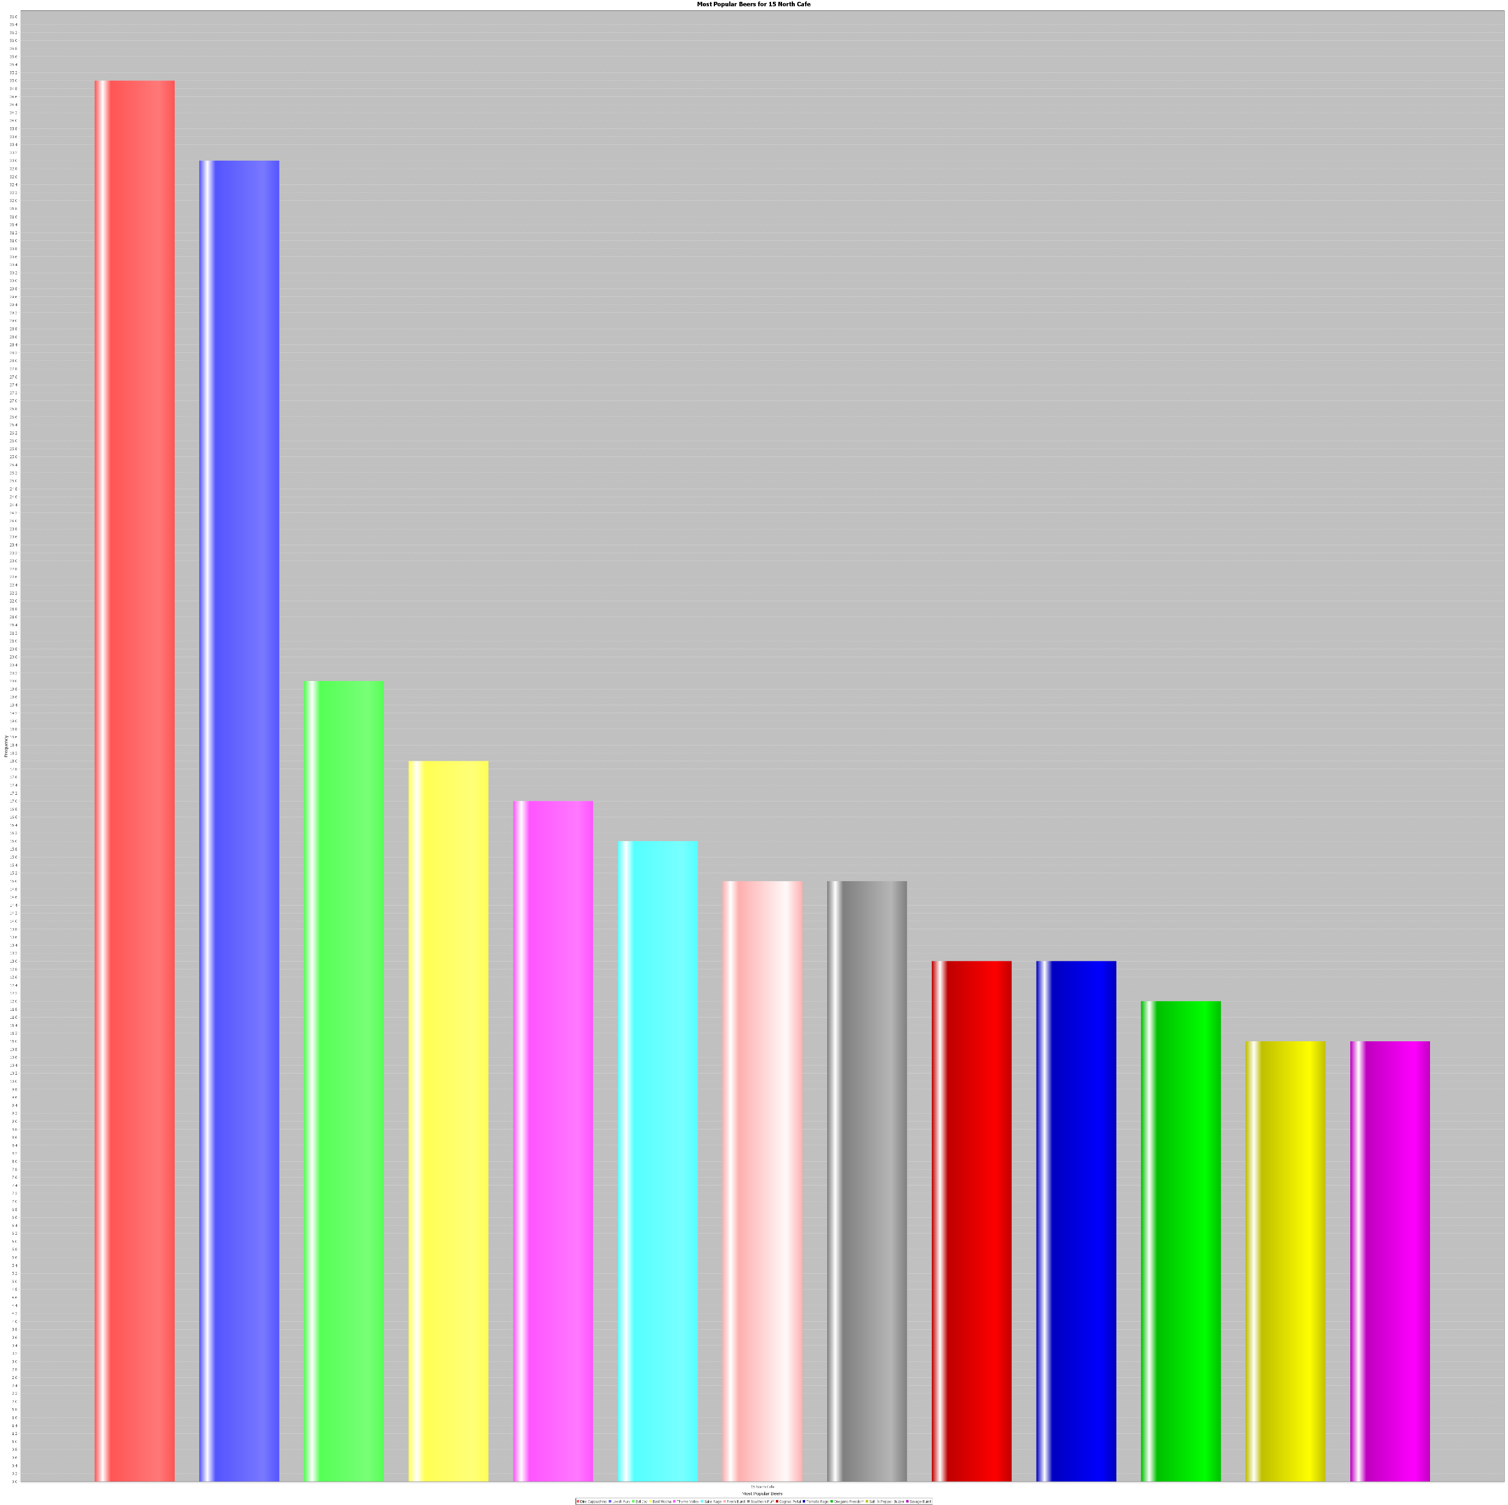
An Example of a Table
Most Popular Beers for 15 North Cafe

